Slide 1
Raspberry Pi3-ModSecurity

Slide 2


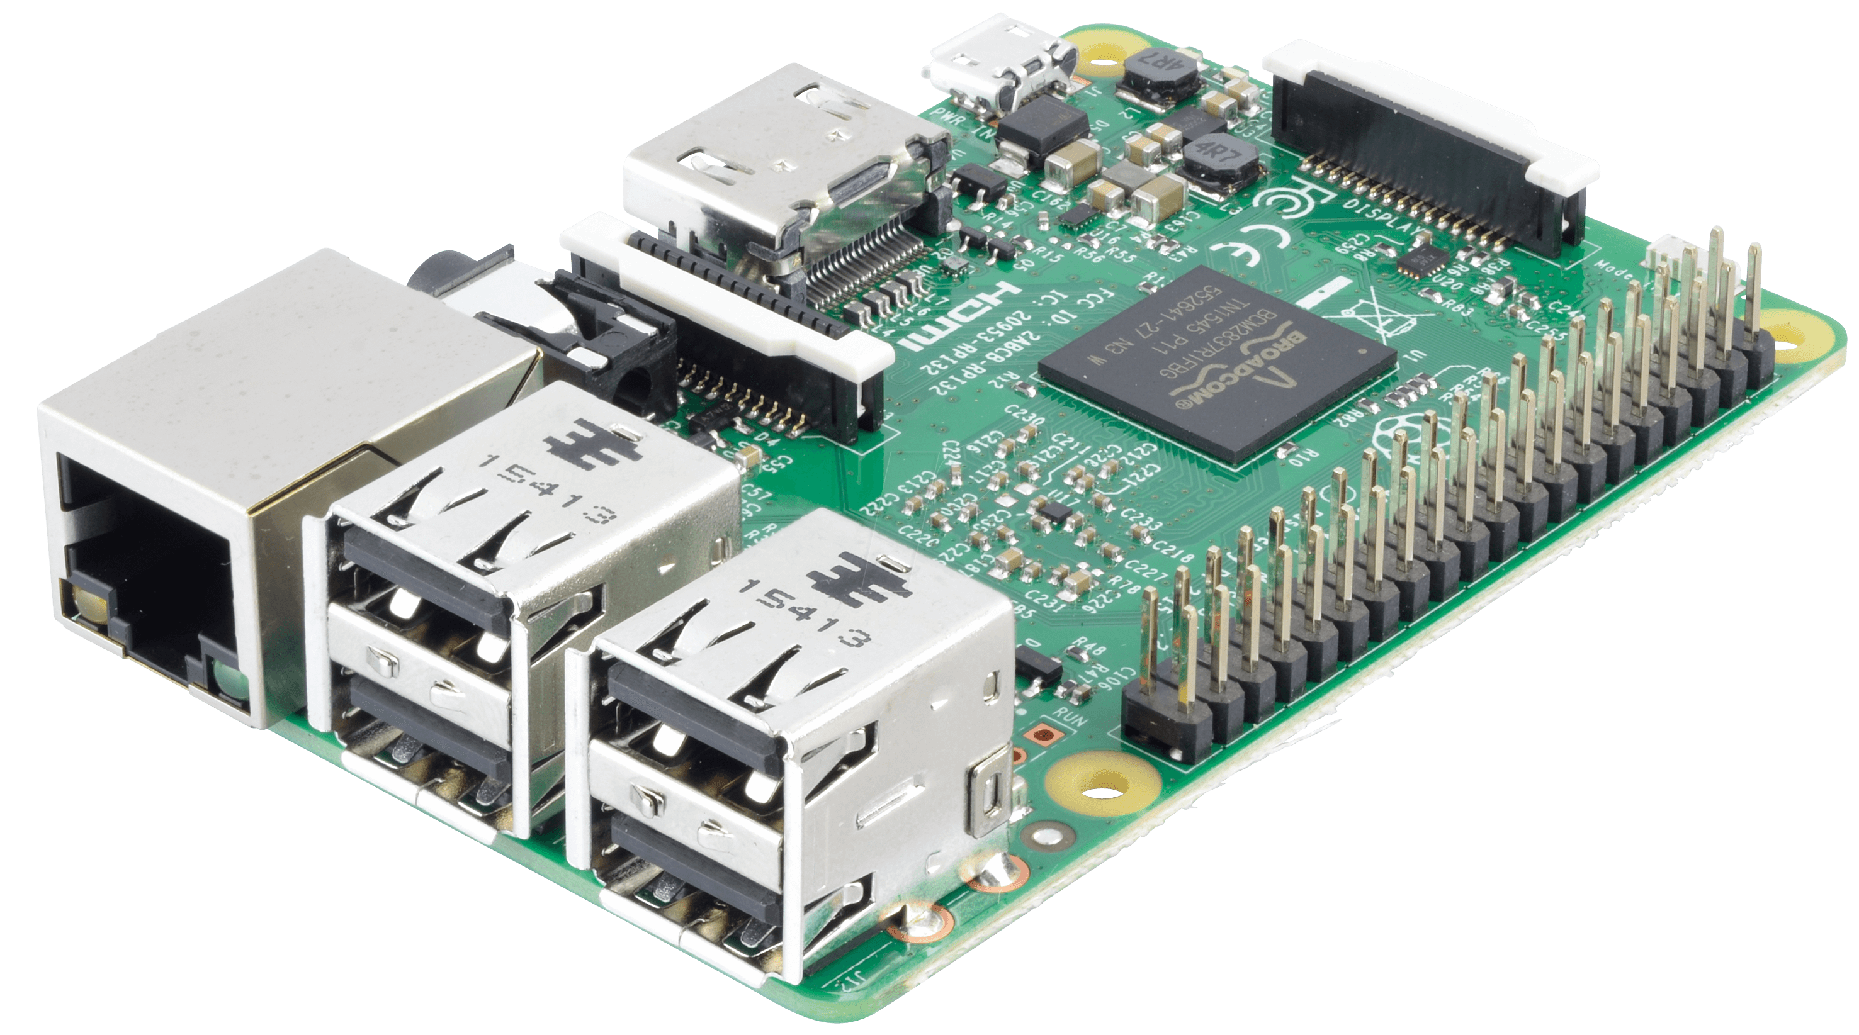

環境
SQL injection rules

Slide 3
DVWA

Slide 4
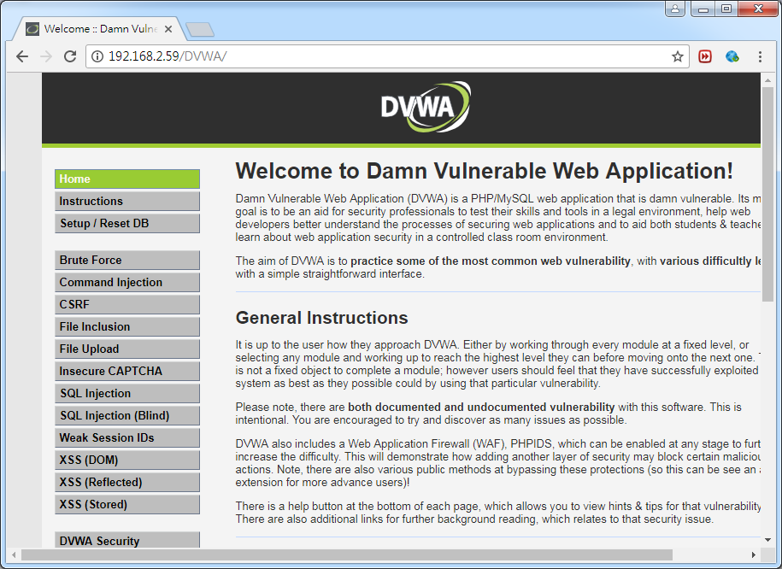
Install DVWA
sudo apt-get install apache2 php libapache2-mod-php php-curl php-mcrypt php-mbstring phpunit php-gd -y
sudo apt-get install mysql-server php-mysqli -y
sudo service apache2 restart
cd /var/www/html
sudo git clone https://github.com/ethicalhack3r/DVWA.git
sudo cp DVWA/config/config.inc.php.dist DVWA/config/config.inc.php
sudo vim DVWA/config/config.inc.php
-----------------------------------------------------
$_DVWA[ 'db_user' ] = 'root';
$_DVWA[ 'db_password' ] = 'xxxxxxxxxx';
$_DVWA[ 'recaptcha_public_key' ] = 'xxxxxxxxxxxxxx';
$_DVWA[ 'recaptcha_private_key' ] = 'xxxxxxxxxxxxx';
$_DVWA[ 'default_security_level' ] = 'low';
-----------------------------------------------------
sudo vim /etc/php/7.0/apache2/php.ini
-----------------------------------------------------
allow_url_include = On
-----------------------------------------------------
sudo chmod 777 /var/www/html/DVWA/hackable/uploads/
sudo chmod 777 /var/www/html/DVWA/external/phpids/0.6/lib/IDS/tmp/phpids_log.txt
sudo service apache2 restart

Slide 5
SQL injection
Database
name | password
AAA | BBB
ABC | 123
SELECT * FROM users WHERE name = 'ABC' and password = '123'
True
SELECT * FROM users WHERE name = 'CCC' and password = 'DDD'
False
SQL injection
SELECT * FROM users WHERE name = '1' OR '1'='1' and password = '1' OR '1'='1'
True
SELECT * FROM users
True

Slide 6
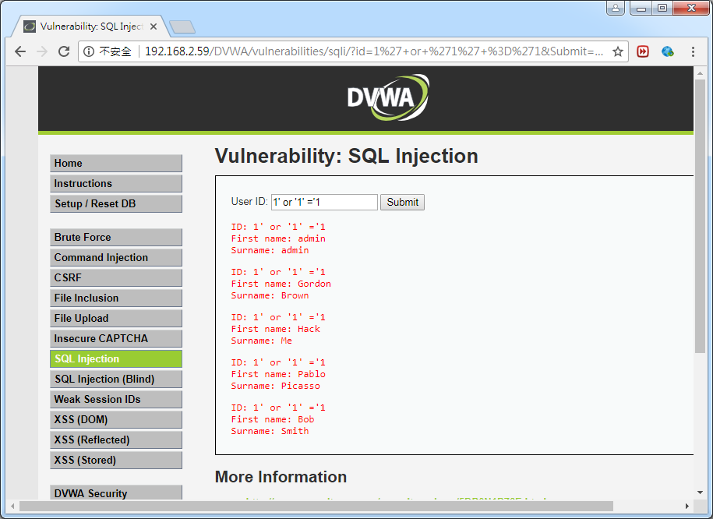
Before
1' or '1' ='1

Slide 7
ModSecurity

Slide 8
Install ModSecurity
sudo apt-get update
sudo apt-get install libapache2-modsecurity -y
hostname
sudo vim /etc/apache2/conf-available/fqdn.conf
------------------------------
ServerName ksu-VirtualBox
------------------------------
sudo a2enconf fqdn && sudo systemctl reload apache2
sudo service apache2 reload
sudo apachectl -M | grep --color security2
sudo mv /etc/modsecurity/modsecurity.conf-recommended /etc/modsecurity/modsecurity.conf
sudo service apache2 reload
sudo sed -i "s/SecRuleEngine DetectionOnly/SecRuleEngine On/" /etc/modsecurity/modsecurity.conf
sudo sed -i "s/SecResponseBodyAccess On/SecResponseBodyAccess Off/" /etc/modsecurity/modsecurity.conf

Slide 9
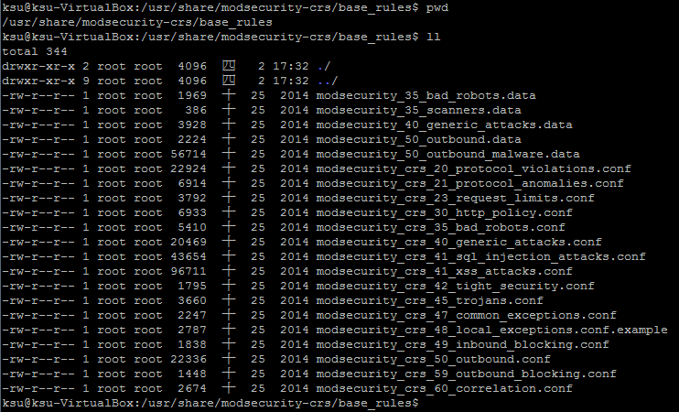
ModSecurity default rules
/usr/share/modsecurity-crs/base_rules

Slide 10
Include ModSecurity
sudo vim /etc/apache2/mods-enabled/security2.conf
------------------------------------------------------------------------------------
<IfModule security2_module>
# Default Debian dir for modsecurity's persistent data
SecDataDir /var/cache/modsecurity
# Include all the *.conf files in /etc/modsecurity.
# Keeping your local configuration in that directory
# will allow for an easy upgrade of THIS file and
# make your life easier
IncludeOptional /etc/modsecurity/*.conf
IncludeOptional "/usr/share/modsecurity-crs/*.conf"
IncludeOptional "/usr/share/modsecurity-crs/activated_rules/*.conf"
</IfModule>
------------------------------------------------------------------------------------
sudo service apache2 reload
sudo cp /usr/share/modsecurity-crs/base_rules/modsecurity_crs_41_sql_injection_attacks.conf /usr/share/modsecurity-crs/activated_rules/
sudo service apache2 reload
https://github.com/fabiocicerchia/OWASP-CRS/blob/master/base_rules/modsecurity_crs_41_sql_injection_attacks.conf
測試只加入sql injection規則

Slide 11
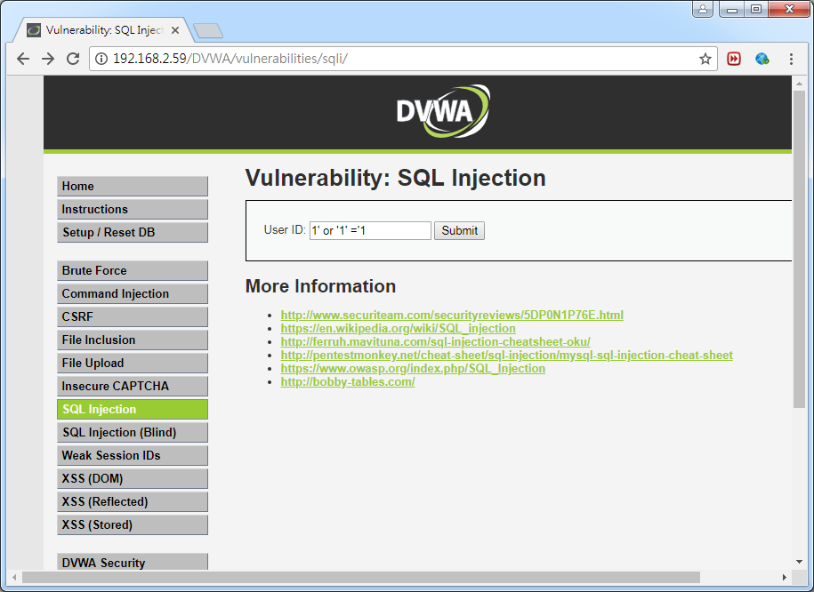
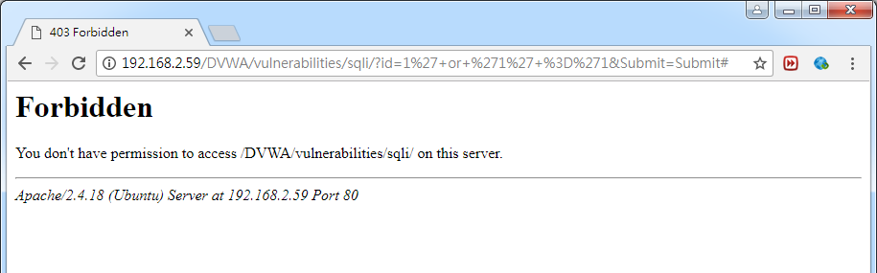
After
1' or '1' ='1

Slide 12
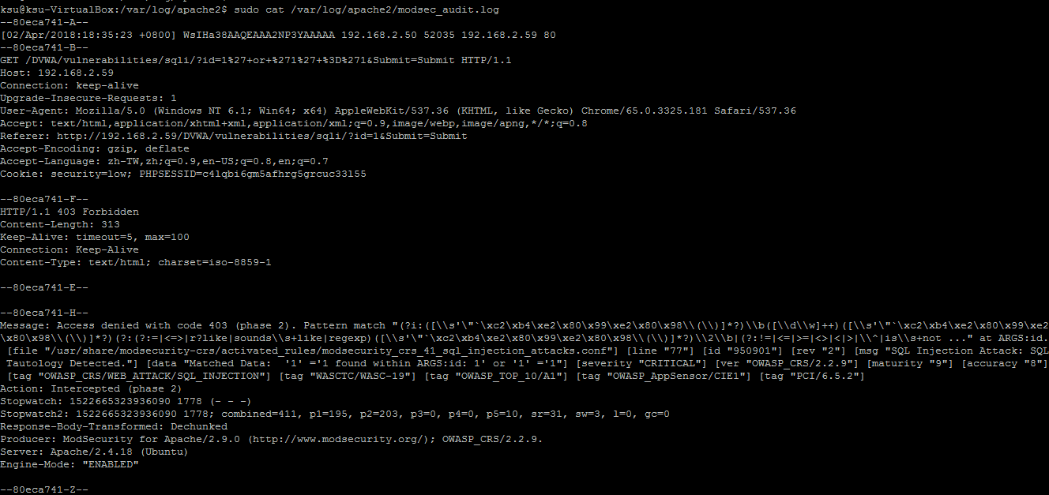
ModSecurity log
sudo cat /var/log/apache2/modsec_audit.log

Slide 13
Modsecurity
JSON log

Slide 14
Install ModSecurity
用apt-get install libapache2-modsecurity裝modsecurity只有到2.9.0版
modsecurity 2.9.1版才開始支援log輸出json格式
所以要手動編譯裝modsecurity
sudo apt-get update
sudo apt-get install libpcre3 libpcre3-dev
sudo apt-get install apache2-dev libxml2-dev liblua5.1-0-dev libcurl4-gnutls-dev libyajl-dev make curl
sudo apt-get install libxml-libxml-perl
sudo apt-get install --reinstall libxml-libxml-perl
su
cd /opt/
curl -LO https://github.com/SpiderLabs/ModSecurity/releases/download/v2.9.2/modsecurity-2.9.2.tar.gz
tar xvf modsecurity-2.9.2.tar.gz
cd modsecurity-2.9.2
./configure --prefix=/usr/local
make
sudo make install

Slide 15
Install ModSecurity
mkdir /etc/modsecurity
cp /opt/modsecurity-2.9.2/{modsecurity.conf-recommended,unicode.mapping} /etc/modsecurity
cp /etc/modsecurity/modsecurity.conf-recommended /etc/modsecurity/modsecurity.conf
sudo sed -i "s/SecRuleEngine DetectionOnly/SecRuleEngine On/" /etc/modsecurity/modsecurity.conf
sudo sed -i "s/SecResponseBodyAccess On/SecResponseBodyAccess Off/" /etc/modsecurity/modsecurity.conf
sudo sed -i '$a SecAuditLogFormat JSON' /etc/modsecurity/modsecurity.conf
sudo sed -i "s/SecAuditLog /#SecAuditLog /" /etc/modsecurity/modsecurity.conf
sed -i '$a SecAuditLog /var/log/apache2/modsec_audit.log' /etc/modsecurity/modsecurity.conf
mkdir /var/cache/modsecurity
chown www-data /var/cache/modsecurity
vim /etc/apache2/mods-available/security2.load
# Depends: unique_id
LoadFile libxml2.so.2
LoadModule security2_module /usr/local/lib/mod_security2.so

Slide 16
Install ModSecurity
vim /etc/apache2/mods-available/security2.conf
<IfModule security2_module>
SecDataDir /var/cache/modsecurity
Include "/etc/modsecurity/modsecurity.conf"
Include "/usr/share/modsecurity-crs/modsecurity_crs_10_setup.conf"
Include "/usr/share/modsecurity-crs/activated_rules/*.conf"
</IfModule>
cd /opt
curl -LO https://github.com/SpiderLabs/owasp-modsecurity-crs/archive/v2.2/master.zip
unzip master.zip
mv owasp-modsecurity-crs-2.2-master/ modsecurity-crs/
mv modsecurity-crs/ /usr/share
cd /usr/share/modsecurity-crs/
cp modsecurity_crs_10_setup.conf.example modsecurity_crs_10_setup.conf
sudo cp /usr/share/modsecurity-crs/base_rules/modsecurity_crs_41_sql_injection_attacks.conf /usr/share/modsecurity-crs/activated_rules/

Slide 17
Install ModSecurity
a2enmod security2
service apache2 restart
systemctl daemon-reload
apachectl -M | grep security2
service apache2 reload

Slide 18
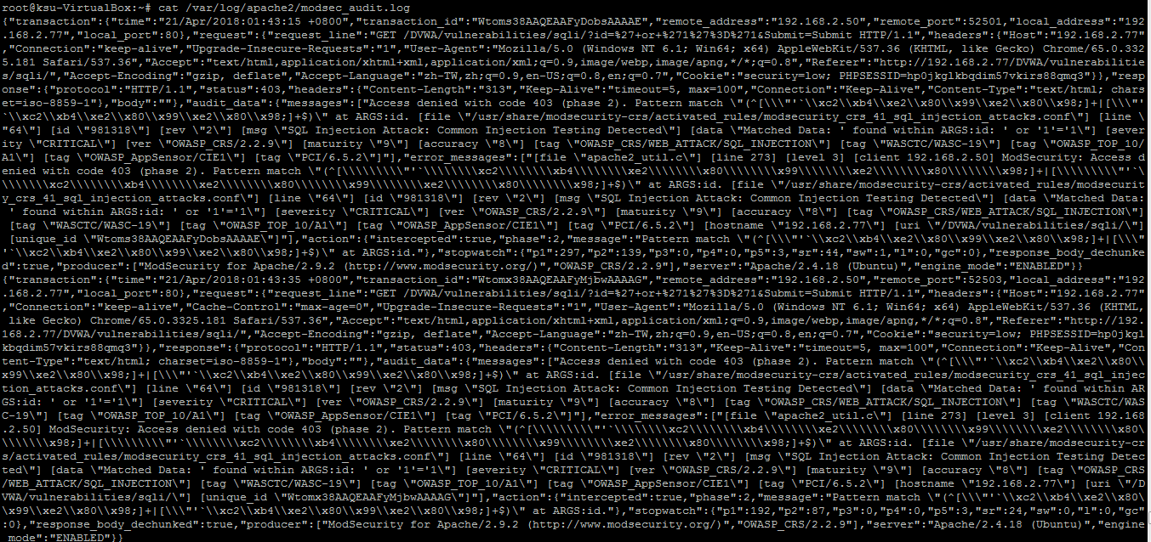
ModSecurity log
cat /var/log/apache2/modsec_audit.log
json log

